Slide 1
Machine learning

Slide 2
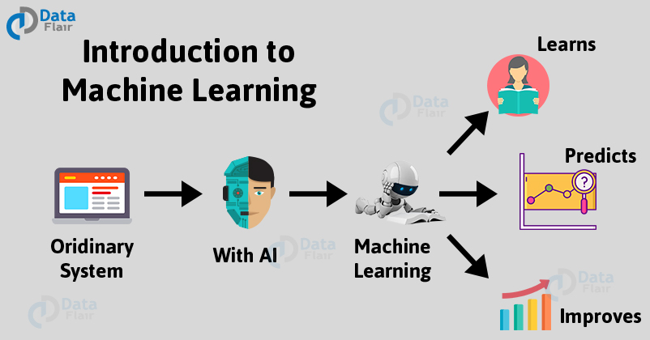
What is Machine Learning?
Machine Learning (ML) is that field of computer science with the help of which computer systems can provide sense to data in much the same way as human beings do.
In simple words, ML is a type of artificial intelligence that extract patterns out of raw data by using an algorithm or method. The main focus of ML is to allow computer systems learn from experience without being explicitly programmed or human intervention.
Machine Learning algorithms are trained over instances or examples through which they learn from past experiences and also analyze the historical data. Therefore, as it trains over the examples, again and again, it is able to identify patterns in order to make predictions about the future.

Slide 3
Need for Machine Learning
The most suitable reason for doing this is, “to make decisions, based on data, with efficiency and scale”.
Lately, organizations are investing heavily in newer technologies like Artificial Intelligence, Machine Learning and Deep Learning to get the key information from data to perform several real-world tasks and solve problems. We can call it data-driven decisions taken by machines, particularly to automate the process. These data-driven decisions can be used, instead of using programing logic, in the problems that cannot be programmed inherently. The fact is that we can’t do without human intelligence, but other aspect is that we all need to solve real-world problems with efficiency at a huge scale. That is why the need for machine learning arises.
. Machine Learning has revolutionized the way we perceive information and the various insights we can gain out of it.

Slide 4
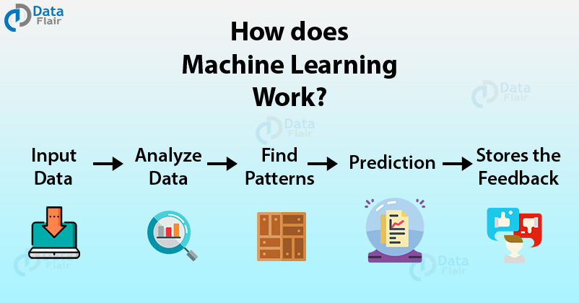
These machine learning algorithms use the patterns contained in the training data to perform classification and future predictions. Whenever any new input is introduced to the ML model, it applies its learned patterns over the new data to make future predictions. Based on the final accuracy, one can optimize their models using various standardized approaches. In this way, Machine Learning model learns to adapt to new examples and produce better results.

Slide 5
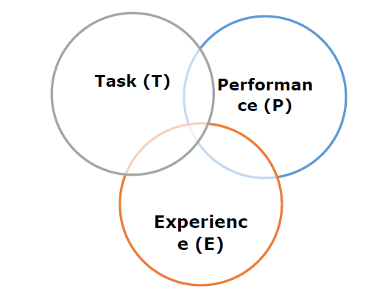
Machine Learning Model
ML is a field of AI consisting of learning algorithms that −
Improve their performance (P)
At executing some task (T)
Over time with experience (E)
Based on the above, the following diagram represents a Machine Learning Model −
Machine Learning Model
The examples of ML based tasks are Classification, Regression, Structured annotation, Clustering, Transcription etc.
Supervised, unsupervised and reinforcement learning are some ways to learn or gain experience.
There are many metrics that help to understand the ML performance, such as accuracy score, F1 score, confusion matrix, precision, recall, sensitivity etc.

Slide 6
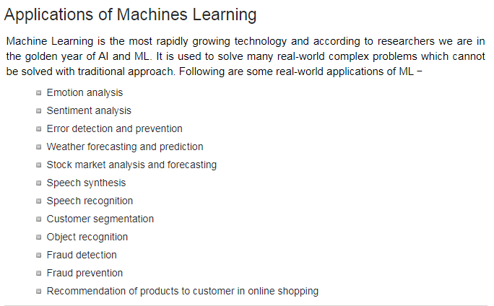

Slide 7
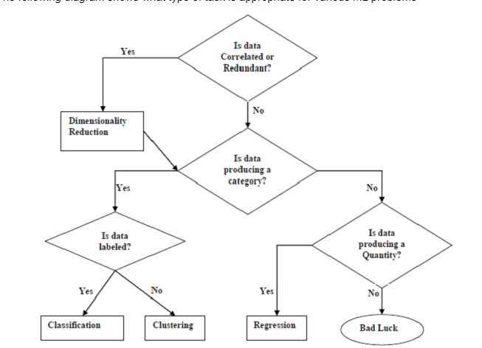

Slide 8
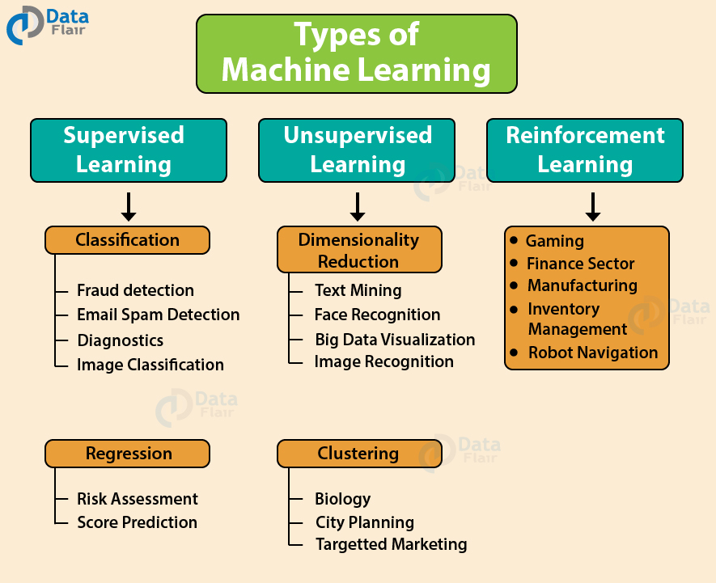

Slide 9
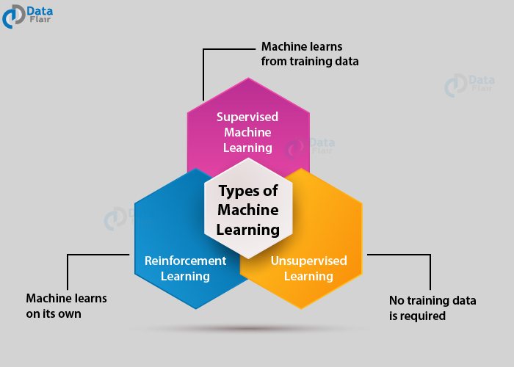
Types/methods of Machine Learning
Machine Learning Algorithms can be classified into 3 types as follows –
Supervised Learning
Unsupervised Learning
Reinforcement Learning

Slide 10
Supervised learning
In Supervised Learning, the dataset on which we train our model is labeled.
There is a clear and distinct mapping of input and output.
Based on the example inputs, the model is able to get trained in the instances.
An example of supervised learning is spam filtering.
Based on the labeled data, the model is able to determine if the data is spam or ham. This is an easier form of training.
Spam filtering is an example of this type of machine learning algorithm.
Supervised learning as the name suggests getting supervised by someone. It is a learning in which the machine uses data which is already tagged with the correct answer. After that, the machine is provided with a new set of data.
With the help of supervised learning, the algorithm analyzes the training data (set of training examples) and produces a correct outcome from labeled data.
Here the machine has already learned the things from previous data. So, now is the time it uses the learning wisely.

Slide 11
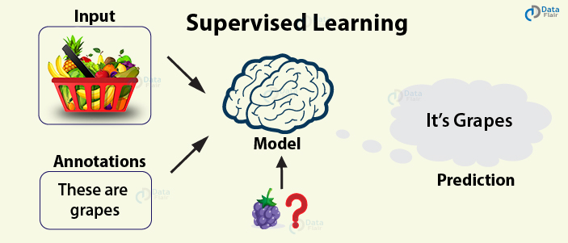
For example – if we take a fruit basket, the machine will first classify the fruit with its shape and color and would confirm the fruit name. If one searches for grapes, then machine learning from its training data (basket containing fruits) will use the prior knowledge.
It will then apply the knowledge to test data and will then provide you with the results.
In supervised learning, we start with a dataset that has training examples, each example has an associated label which identifies it.

Slide 12
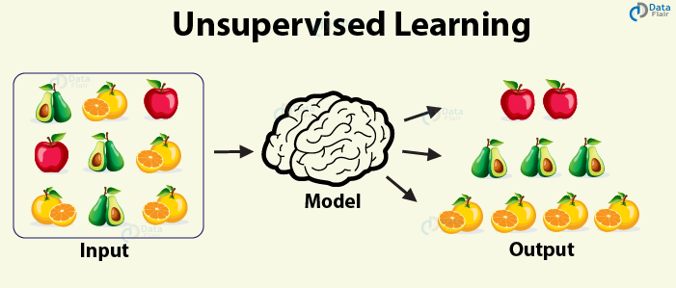
Unsupervised Learning
In Unsupervised Learning, there is no labeled data.
The algorithm identifies the patterns within the dataset and learns them.
The algorithm groups the data into various clusters based on their density.
Using it, one can perform visualization on high dimensional data.
One example of this type of Machine learning algorithm is the Principle Component Analysis.
Furthermore, K-Means Clustering is another type of Unsupervised Learning where the data is clustered in groups of a similar order.
The learning process in Unsupervised Learning is solely on the basis of finding patterns in the data. After learning the patterns, the model then makes conclusions.

Slide 13
Clustering
Clustering, also known as cluster analysis, is a technique of grouping similar sets of objects in the same group that is different from the objects in other group. Some of the essential clustering techniques are as follows –
K-means
DBSCAN
Hierarical clustering
The model is able to learn from the data by finding implicit patterns. Unsupervised Learning algorithms identify the data based on their densities, structures, similar segments, and other similar features. Unsupervised Learning Algorithms are based on Hebbian Learning. Cluster analysis is one of the most widely used techniques in supervised learning
One of the most popular unsupervised learning techniques is clustering. Using clustering, businesses are able to capture potential customer segments for selling their products. Sales companies are able to identify customer segments that are most likely to use their services. Companies can evaluate the customer segments and then decide to sell their product to maximize the profits.

Slide 14
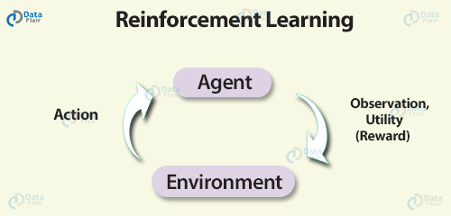
Reinforcement learning is a very interesting kind of learning. There’s no answer key which can tell what’s right. But, the reinforcement learning agent still decides how to act to perform its task. This machine learning technique is all about taking actions that are suitable and maximize the reward in a particular situation. It is when the learner receives rewards and punishments for their actions.
For example – In a given scenario, the reward could be utility and the agent could be told to receive as much utility as possible in order to “win”.
Basically, the agent decides what to do to perform the given task. Now, since the training dataset is missing, it is bound to learn from its experience.

Slide 15
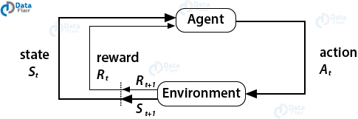

Reinforcement Learning
covers more area of Artificial Intelligence which allows machines to interact with their dynamic environment in order to reach their goals. With this, machines and software agents are able to evaluate the ideal behavior in a specific context. With the help of this reward feedback, agents are able to learn the behavior and improve it in the longer run. This simple feedback reward is known as a reinforcement signal.
The agent in the environment is required to take actions that are based on the current state. This type of learning is different from Supervised Learning in the sense that the training data in the former has output mapping provided such that the model is capable of learning the correct answer. Whereas, in the case of reinforcement learning, there is no answer key provided to the agent when they have to perform a particular task. When there is no training dataset, it learns from its own experience.

Slide 16
Reinforcement Learning Use Case
Google’s Active Query Answering (AQA) system makes use of reinforcement learning. Google’s AQA system reformulates the questions asked by the user. For example, if you ask the AQA bot the question – “What is the birth date of Nikola Tesla” then the bot would reformulate it into different questions like “What is the birth year of Nikola Tesla”, “When was Tesla born?” and “When is Tesla’s birthday”. This process of reformulation utilized the traditional sequence2sequence model, but Google has integrated reinforcement Learning into its system to better interact with the query based environment system.

Slide 17
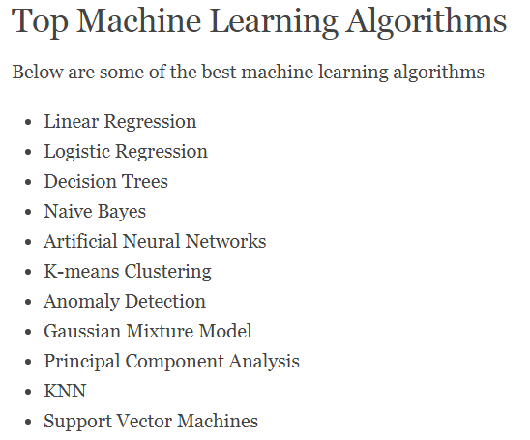
These ML algorithms are quite essential for developing predictive modeling and for carrying out classification and prediction. These ML algorithms are the most useful for carrying out prediction and classification in both supervised as well as unsupervised scenarios.

Slide 18
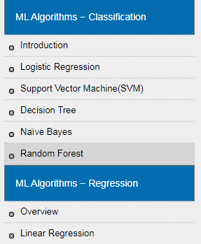
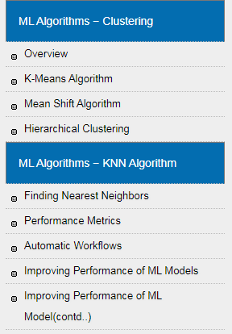

Slide 19
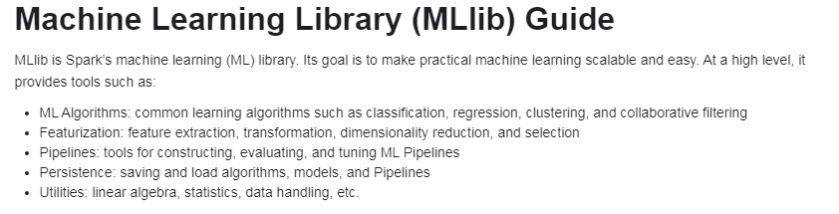
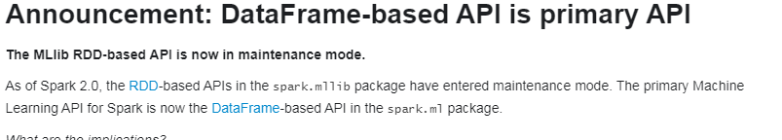
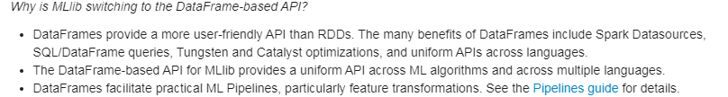

Slide 20
Classification
Logistic regression
Logistic regression is a popular method to predict a categorical response.

Slide 21
Introduction to Logistic Regression
Logistic regression is a supervised learning classification algorithm used to predict the probability of a target variable. The nature of target or dependent variable is dichotomous, which means there would be only two possible classes.
In simple words, the dependent variable is binary in nature having data coded as either 1 (stands for success/yes) or 0 (stands for failure/no).
Mathematically, a logistic regression model predicts P(Y=1) as a function of X. It is one of the simplest ML algorithms that can be used for various classification problems such as spam detection, Diabetes prediction, cancer detection etc.
Types of Logistic Regression
Generally, logistic regression means binary logistic regression having binary target variables, but there can be two more categories of target variables that can be predicted by it. Based on those number of categories, Logistic regression can be divided into following types −
Binary or Binomial
In such a kind of classification, a dependent variable will have only two possible types either 1 and 0. For example, these variables may represent success or failure, yes or no, win or loss etc.
Multinomial
In such a kind of classification, dependent variable can have 3 or more possible unordered types or the types having no quantitative significance. For example, these variables may represent “Type A” or “Type B” or “Type C”.
Ordinal
In such a kind of classification, dependent variable can have 3 or more possible ordered types or the types having a quantitative significance. For example, these variables may represent “poor” or “good”, “very good”, “Excellent” and each category can have the scores like 0,1,2,3.

Slide 22
Regression Models
Binary Logistic Regression Model − The simplest form of logistic regression is binary or binomial logistic regression in which the target or dependent variable can have only 2 possible types either 1 or 0.
Multinomial Logistic Regression Model − Another useful form of logistic regression is multinomial logistic regression in which the target or dependent variable can have 3 or more possible unordered types i.e. the types having no quantitative significance.

Slide 23
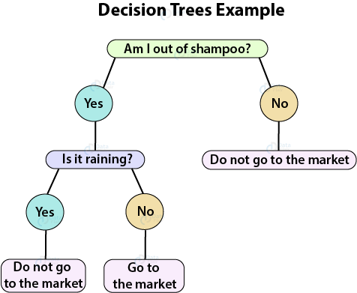
Introduction to Decision Tree
Decision trees can be constructed by an algorithmic approach that can split the dataset in different ways based on different conditions. Decisions trees are the most powerful algorithms that falls under the category of supervised algorithms.
They can be used for both classification and regression tasks. The two main entities of a tree are decision nodes, where the data is split and leaves, where we got outcome. The example of a binary tree for predicting whether a person is fit or unfit providing various information like age, eating habits and exercise habits, is given below −

Slide 24
In the above decision tree, the question are decision nodes and final outcomes are leaves. We have the following two types of decision trees.
Classification decision trees − In this kind of decision trees, the decision variable is categorical. The above decision tree is an example of classification decision tree.
Regression decision trees − In this kind of decision trees, the decision variable is continuous.
Introduction to Naïve Bayes Algorithm
Naïve Bayes algorithms is a classification technique based on applying Bayes’ theorem with a strong assumption that all the predictors are independent to each other. In simple words, the assumption is that the presence of a feature in a class is independent to the presence of any other feature in the same class. For example, a phone may be considered as smart if it is having touch screen, internet facility, good camera etc. Though all these features are dependent on each other, they contribute independently to the probability of that the phone is a smart phone.
In Bayesian classification, the main interest is to find the posterior probabilities i.e. the probability of a label given some observed features, 𝑃(𝐿 | 𝑓𝑒𝑎𝑡𝑢𝑟𝑒𝑠). With the help of Bayes theorem, we can express this in quantitative form as follows −

Slide 25
P(L|features)=P(L)P(features|L) / P(features)
P(L|features)=P(L)P(features|L)P(features)
Here, (𝐿 | 𝑓𝑒𝑎𝑡𝑢𝑟𝑒𝑠) is the posterior probability of class.
𝑃(𝐿) is the prior probability of class.
𝑃(𝑓𝑒𝑎𝑡𝑢𝑟𝑒𝑠|𝐿) is the likelihood which is the probability of predictor given class.
𝑃(𝑓𝑒𝑎𝑡𝑢𝑟𝑒𝑠) is the prior probability of predictor.

